Slide 1
Sensors and Transducers
Light Sensors
  Light Dependent Resistor
    Glass window allows light to fall on a zigzag pattern of cadmium sulfide whose resistance depends on the amount of light present
      Advantages:
        Inexpensive
        Durable
        Sensitive
      Disadvantages:
        Do not have a very fast response time
        Not stable with Temperature

Slide 2
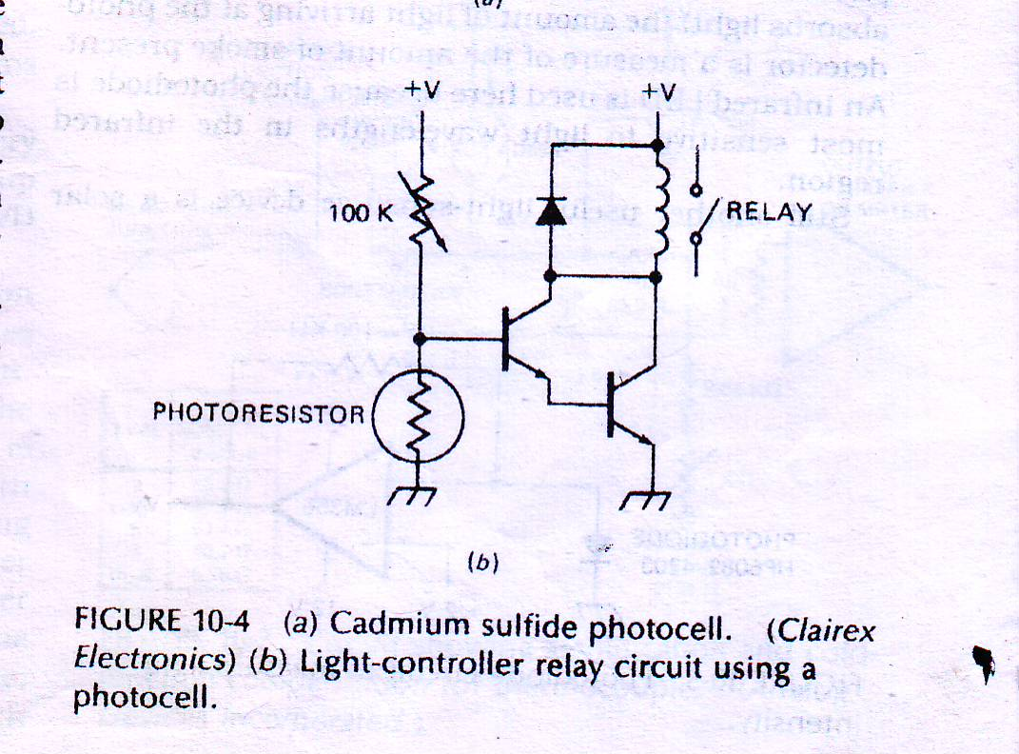
  Photocell
In dark– resistance of photoresistor goes up
  Increases the voltage on the base of the transistor
    Transistor turns on
      Turns on relay
        Switches on the lamp

Slide 3
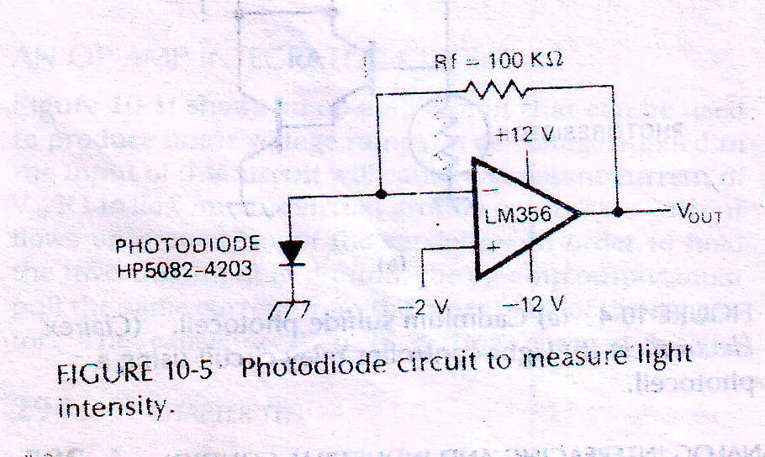
Photodiode
Light is allowed to fall on the junction of a specially constructed silicon diode
  Reverse leakage current increases linearly as the amount of light increases
Leakage current is converted into proportional voltage
Can also be used for smoke detection
Solar Cell
  Very heavily doped silicon PN Junctions
  Light shining on the solar cell causes a reverse current to flow

Slide 4
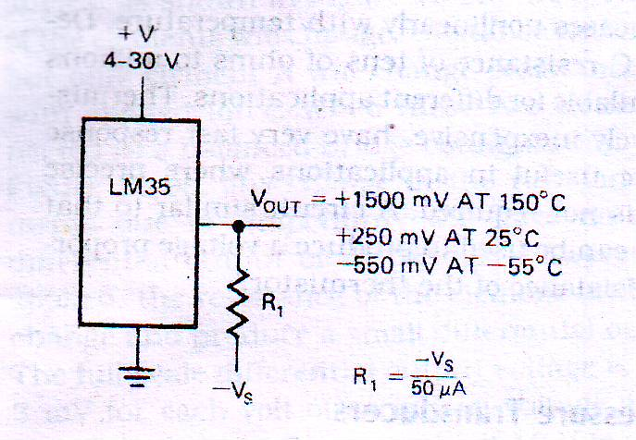
Temperature Sensors
  Semiconductor Devices
  Thermocouples
  RTDs
  Thermistors
  Semiconductor Devices
  Temperature Sensitive Voltage Sources
  Temperature Sensitive Current Sources

Slide 5
Thermocouple
A thermocouple is a junction between two different metals that produces a voltage related to a temperature difference.
When two different metals are put in contact ,a small voltage is produced between them
Voltage depends on
    Type of metals used
    Temperature
The developed voltage increases between 7 and 75 µV for each degree celsius increase in temperature
A thermocouple junction made of iron and constantan is called a type ‘J Thermocouple’
  Temperature range : -184 to +760 degree Celsius
Thermocouple junction can be made of platinum and alloy of platinum-rhodium
  Temperature range : 0 to 1600 degree Celsius
  Thermocouples can be made small, rugged and stable

Slide 6
Problems
1. Output is very small and need to be amplified a great deal
2. A reference junction of same metal must be connected in series with the junction used to make the measurement
  Because thermocouple reading is meaningless without comparing it to another, more accurate temperature sensor usually a reference
One end of the thermocouple--the hot junction--is thermally attached to the object to be measured
Another end of thermocouple– the cold junction– is placed into an ice bath to hold it at a constant temperature
The voltage generated by the loop is a function of the temperature difference between the two junctions.
This phenomenon is known as the Seebeck effect, generally described as the process in which thermal energy is converted into electrical energy.

Slide 7
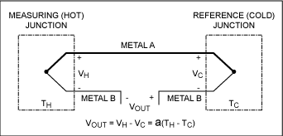

Slide 8
the measured output voltage, VOUT, is the difference between the measuring (hot) junction voltage and the reference (cold) junction voltage. Since VH and VC are generated by a temperature difference between the two junctions, VOUT is also a function of this temperature difference. The scale factor, , which relates the voltage difference to the temperature difference, is known as the Seebeck coefficient.
3. Output voltages do not change linearly with temperature
  Analog circuitry is needed which changes the gain of an amplifier according to the value of the signal

Slide 9
RTDs
Resistance Temperature Detector is another commonly used Temperature Sensor
It is actually a resistor which change value with a change in temperature
It consists of a wire or a thin film of platinum or a nickel wire
Response of RTDs is non-linear but they have excellent
stability (This is the sensor's ability to maintain a consistent output when a constant input is applied)
Repeatability(is the sensor's ability to give the same output or reading under repeated identical conditions.)
It is useful for measures in the range of -250 to +850° C

Slide 10
The resistance of an RTD increases with an increase in temperature
Change in the resistance is converted into a proportional voltage
Thermistor(Thermal Sensitive Resistor)
Thermistors consists of semiconductor materials
Resistance decreases nonlinearly with temperature
Relatively inexpensive
Very fast response time
Applicable where precise measurement is not required

Slide 11
Comparison
 | Thermocouple | RTD | Thermistor
Stability | Reasonable for limited lifetime | Good | Good
Repeatability | Reasonable | Good | Good
Linearity | Non-linear | Non-linear | Non-linear
Reference Junction | Required | Not required | Not required
Contact required | yes | yes | yes
Response Time | Fast | medium | Very fast

Slide 12
Force and pressure Transducer
Strain Gages:
It is a small resistor whose value changes when its length is changed
It is made of thin wire, thin foil or semiconductor material
One end of a piece of spring steel is attached to a fixed surface
A strain gage is glued on the top of the flexible bar
The force or weight to be measured is applied to the unattached end of the bar
As the applied force bend the bar, the strain gage is stretched, increasing its resistance
Since the amount that the bar is bent is directly proportional to the applied force , the change in the resistance will be proportional to the applied force

Slide 13
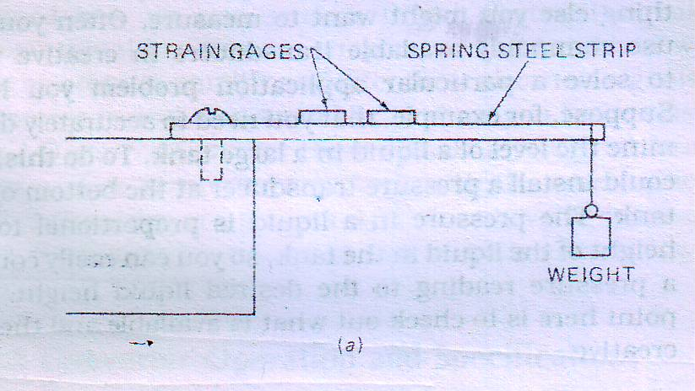
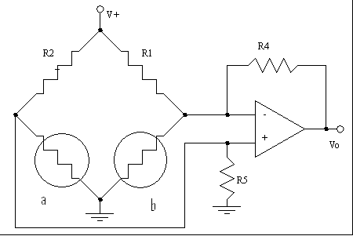
If current is passed through the strain gage, then the change in voltage across the strain gage will be proportional to the applied force
Unfortunately the resistance of strain gage element also changes with temperature
Two Strain gage elements are mounted at right angles
If the elements are connected in a balanced –bridge configuration, any change in the resistance due to temperature will have no effect on the differential output of the bridge

Slide 14
Linear Variable Differential Transformers
LVDT is a transducer often used to measure force, pressure or position
Basic structure of an LVDT consists of
    Three coils of wire wound (1 Primary, 2 secondaries)
    A movable iron core (armature)
An ac excitation signal of perhaps 20 kHz is applied to the primary
The secondaries are connected in opposition such that the voltage induced in one opposes the voltage induced in the other
If the core is centered , then the induced voltages are equal and cancel each other
    So there is no net output voltage

Slide 15
If the coil is moved off center, coupling to one secondary coil will be stronger, so that the coil will produce a greater output voltage
Result will be a net output voltage
The phase relationship between the output signal and the input signal is an indication of which direction the core moved from the center position
The amplitude of the output signal is linearly proportional to how far the core moves from the center position
Thus an LVDT can be used directly in this form to measure displacement or position
If we add a spring so that a force is required to move the core, then the voltage out of LVDT will be proportional to the force applied to the core

Slide 16
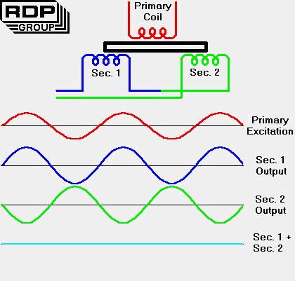

Slide 17
Flow sensor
If we need to control the flow rate of some material , we need to be able to measure it
Depending on the material, flow rate and temperature- different methods are used
We can use a paddle wheel in the flow
The rate at which the paddle wheel turns is proportional to the rate of flow of a liquid or gas
An optical encoder can be attached to the shaft of the paddle wheel to produce digital information as to how fast the paddle wheel is turning
optical encoder is a device that converts motion into a sequence of digital pulses.

Slide 18
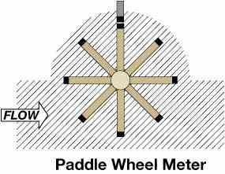
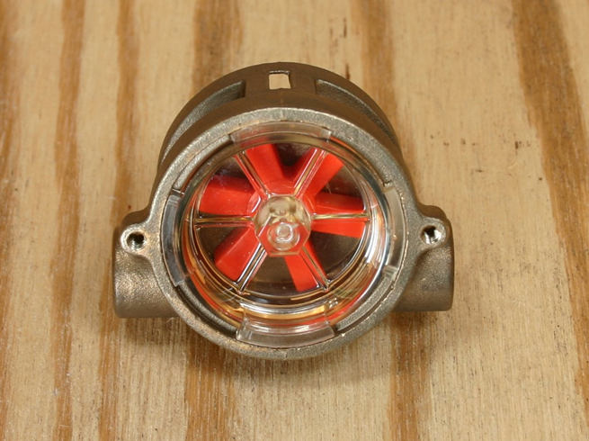

Slide 19
Differential pressure Transducer
A wire mesh or screen is put in the pipe to create some resistance
Flow through this resistance produces a difference in pressure between the two sides of the screen
The pressure transducer gives an output proportional to the difference in the pressure between the two sides of the resistance
Thus the output of a pressure transducer is proportional to the flow of a liquid or gas through the pipe

Slide 20
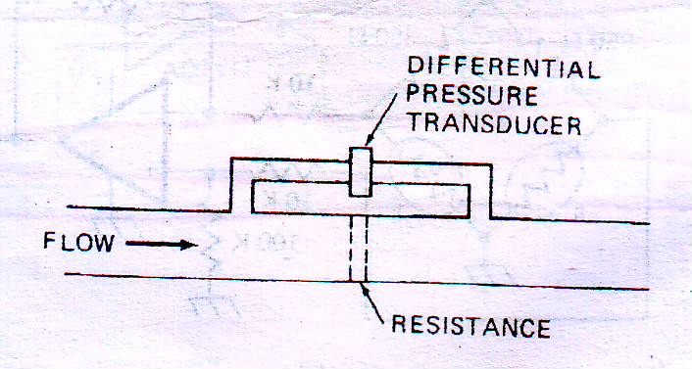
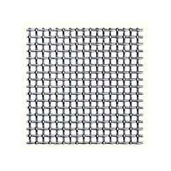
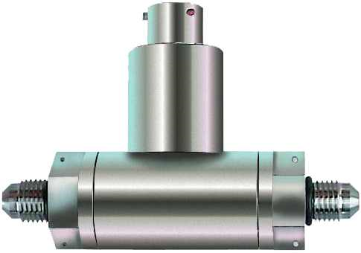
Wire Mesh

Slide 21
D/A Converter
Operation
The purpose of a Digital to Analog converter is to convert a binary word to a proportional current or voltage
In a simple 4 bit D/A converter , inverting input of the circuit is referred to as the summing point
When one of the switches is closed, current will flow from -V to the summing point
The equation of O/P voltage, V_{out} = - Rf/ R₁(V_{in} )
If we close the switch D0 , V_{out} = - 10/ 100(-5) = 0.5 V
If we close the switch D0 & D1 , V_{out} = - 10/ 33.33(-5) = 1.5 V
The point here is that, binary weighted resistors produce currents which are summed by the op amp to produce a proportional output voltage
The heart of a D/A converter is a set of binary weighed current sources which can be switched on or off according to a binary word applied to its input

Slide 22
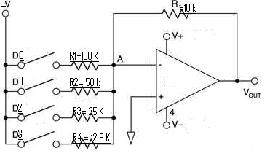
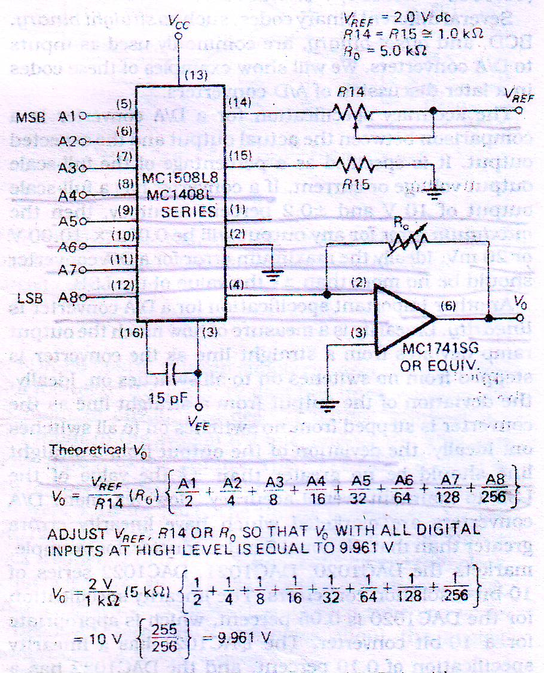

Slide 23
Characteristics
1. Resolution
This is determined by the number of bits in the input binary word
A converter with 8 binary inputs has 2⁸ or 256 possible output levels
Thus its resolution is 1 part in 256
Example:
12 bit converter has a resolution of 1 part in 2¹² or 4096
Resolution is sometimes expressed in percentage
The resolution of an 8 bit converter can be expressed as a percentage is (1/256)*100 percent or 0.39 percent

Slide 24
2. Full scale output voltage
The maximum output voltage of a converter will always have a value 1 least significant bit less than the named value
Example:
12 bit, 10-V converter
The value of 1 LSB = (10V)/4096 = 2.44mV
The highest voltage output for the converter when it is properly adjusted will then be : (10 – 0.0024)V or 9.9976V

Slide 25
3. Accuracy:
The accuracy specification for a D/A converter is a comparison between the actual output and the expected output
It is specified as a percentage of the full scale output voltage or current
Example
If the converter has a output of 10V and ± 0.2 percent accuracy
Maximum error for any output will be 0.002 * 10V or 20mV

Slide 26
4. Linearity
Linearity is the measure of how much the output ramp deviates from a straight line as the converter is stepped from no switches on to all switches on
Ideally the deviation of the output from a straight line should be no greater than ± ½ the value of LSB to maintain overall accuracy

Slide 27
5.Settling Time
When we change the binary word applied to the input of a converter , the output will change to the appropriate new value
The output may overshoot the correct value, “ring” for a while before finally settling down to the correct value
The time the output takes to get within ± ½ LSB of the final value is called settling time
This specification is important, because if a converter is operated at too high frequency, it may not have time to settle to one value before it is switched to the next

